Slide 1
Multi-User DBMS Architecture

Slide 2
Multi-User DBMS Architecture
The architectures that are used to implement multi user DBMS are :
Teleprocessing
File Server
Client Server

Slide 3
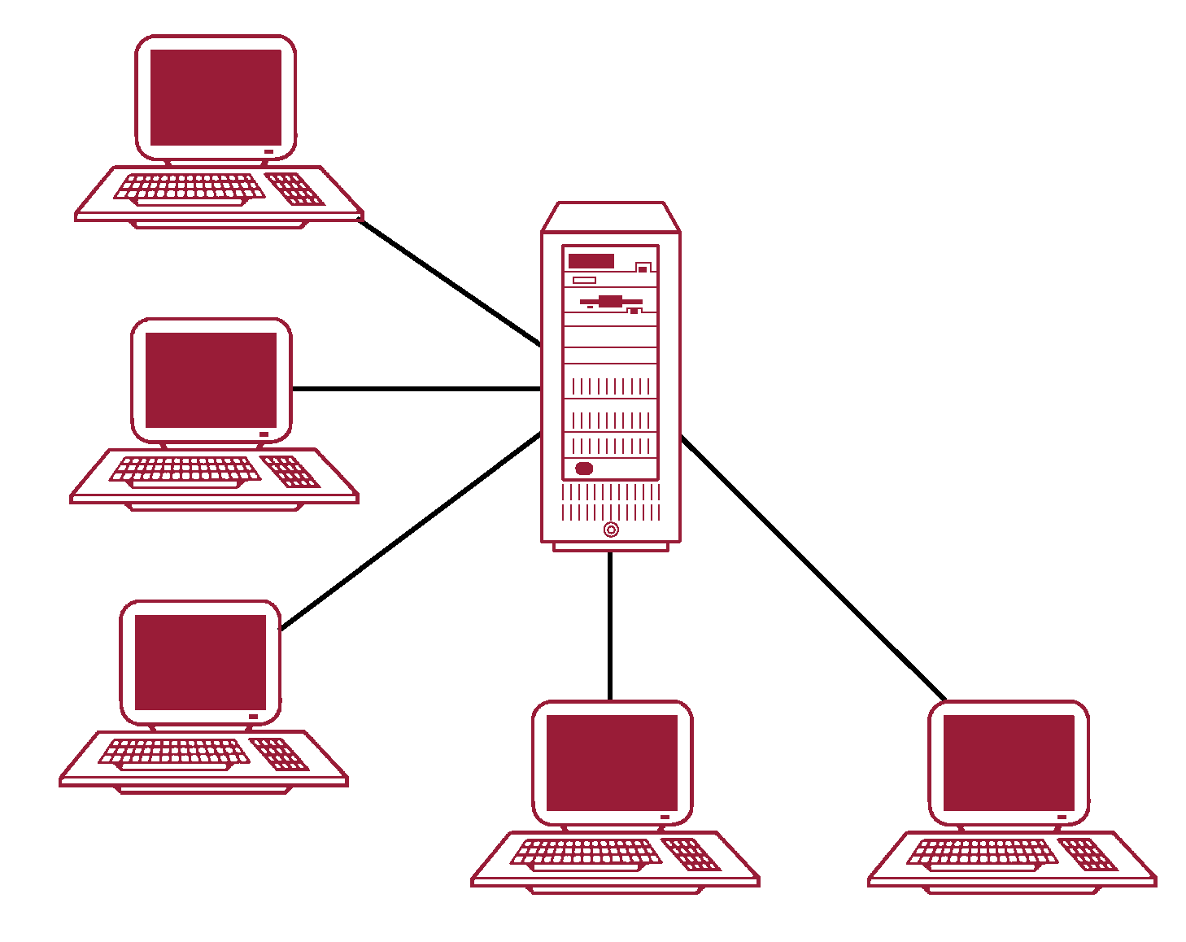
Teleprocessing Topology

Slide 4
Teleprocessing
The traditional architecture for multi-user systems was Teleprocessing, where there is :
One computer with a single Central Processing Unit (CPU) and
A number of terminals.
All processing is performed within the boundaries of the same physical computer.
User terminals are typically the 'Dumb Terminals'. They are incapable of functioning at their own and they are attached by cable to the central computer.
The terminals send messages via the communication control sub-system

Slide 5
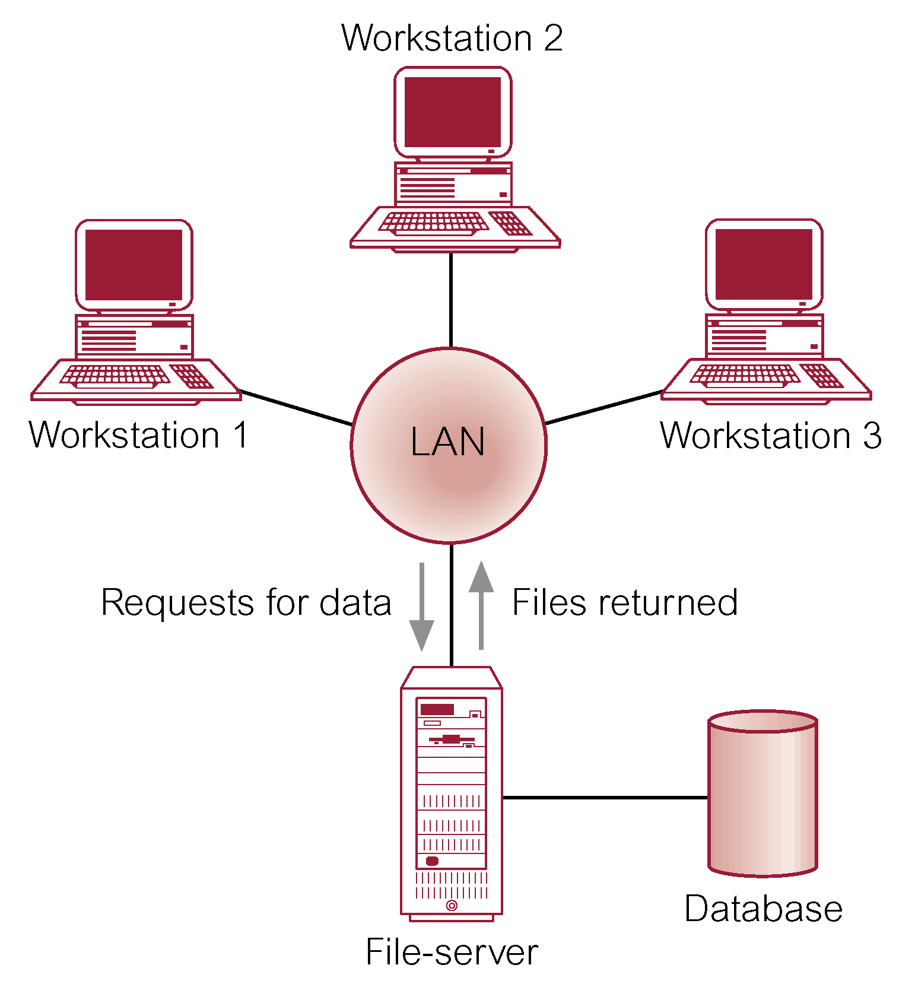
File-Server Architecture

Slide 6
File-Server Architecture
In a file server environment, the processing is distributed about the network, typically the Local Area Network (LAN).
The file server holds the files required by the application and the DBMS.
However, the applications and DBMS run on each workstation, requesting files from the file server when necessary.
The file server acts simply as a shared data disk. The DBMS on each workstation sends requests to the file server for all data that the DBMS requires that it is stored on disk.

Slide 7
File-Server Architecture
This approach can generate significant amount of network traffic, which can lead to performance problems
Three main disadvantages
Large amount of network traffic
Full copy of DBMS required on each workstation
Concurrency, recovery, and integrity control are complex
Multiple DBMSs can access the same files

Slide 8
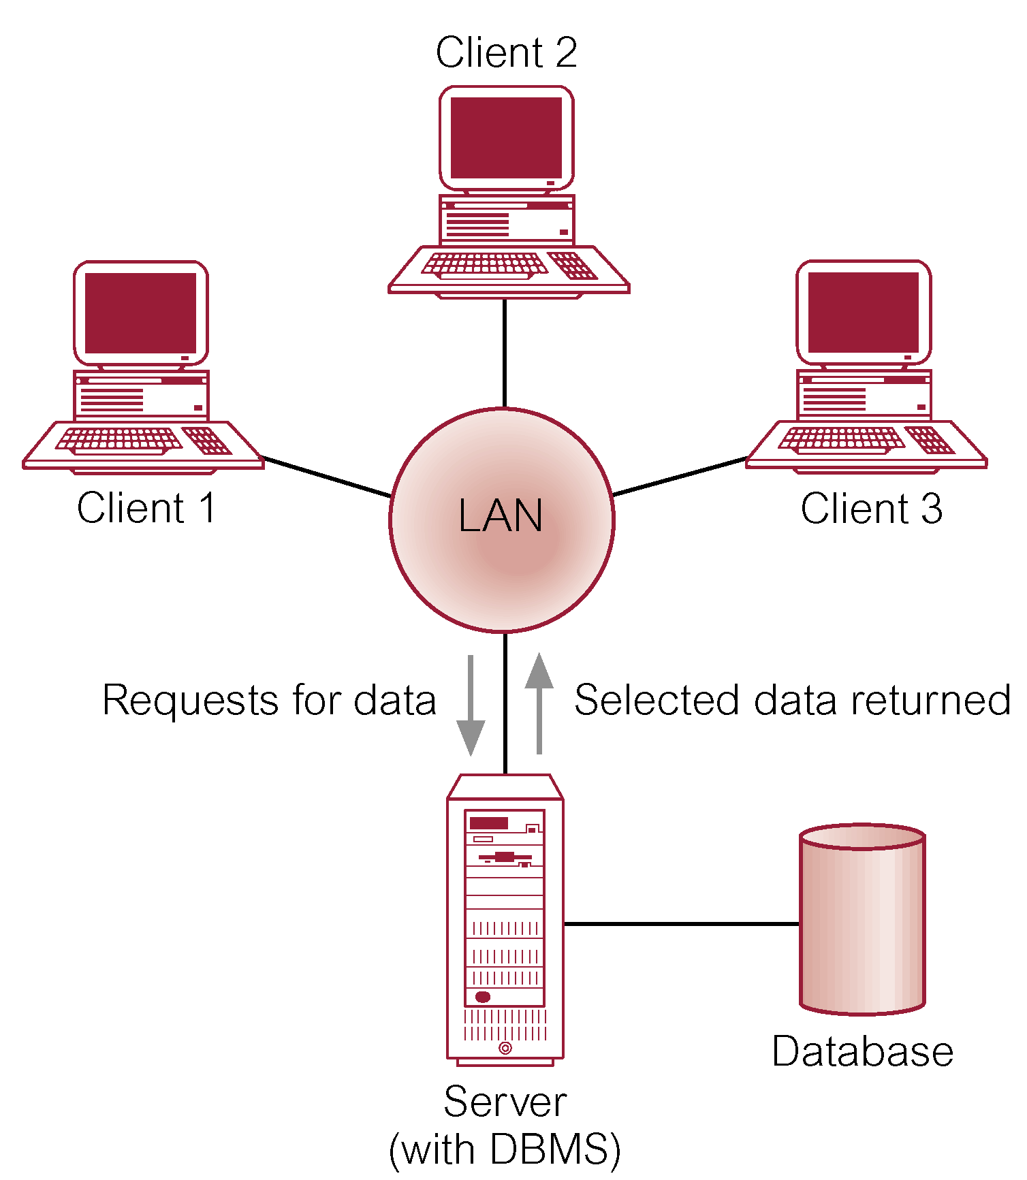
Client-Server Architecture

Slide 9
Client-Server Architecture
To overcome the disadvantages of the first two methods the client-server architecture was developed. As the name suggests there is :
A client process, which requires some resource,
A server process, which provides the resource.
There is no requirement that the client and server must reside on the same machine.
The client process :
In the database context, the client manages the user interface and the application logic.
It takes the user requests.
Checks the syntax.
Generates database requests in SQL or another database language.
Transmits the message to the server, waits for response and formats the response for the end-user.

Slide 10
Client-Server Architecture
The server process :
Accepts and processes the database requests.
Transmits the result to the client.
Processing of the requests involves checking authorization, ensuring integritY, maintaining the system catalog, and performing query and update processing. In addition, it also provides concurrency and recovery control.

Slide 11
Advantage of Client-Server Architecture
It enables wider access to existing databases.
Increased Performance : If the clients and the server reside on different computers then different computers can be processing application in parallel.
Hardware Costs may be Reduced : It is the only server that requires the storage and processing sufficient to store and manage the database.
Communication Costs are Reduced : Applications carry out part of operations on the client and send only the requests for database access over the network.
Increased Consistency : The server can handle integrity checks, so that constraints need be defined and validated only in one place.
It Maps on to Open : System architecture quite naturally.

